Slide 1
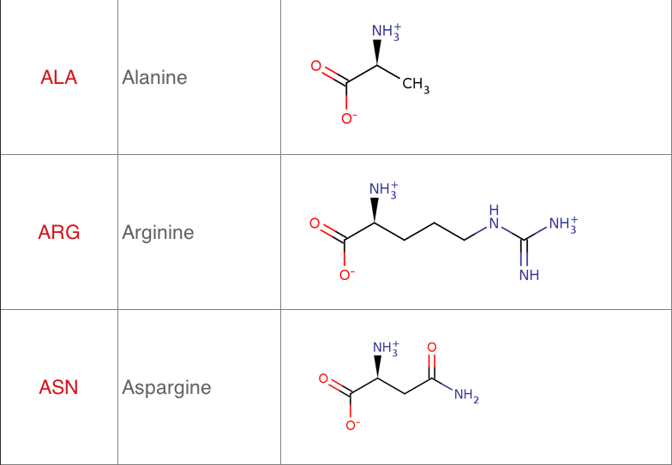
18
18
ALA
ARG
ASN

Slide 2
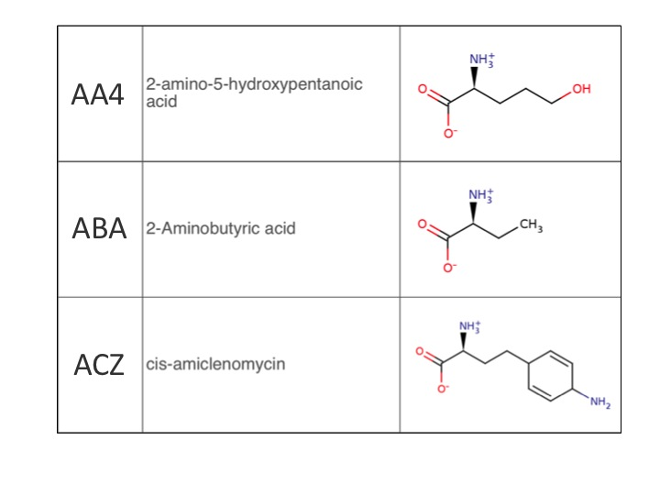
AA4
ABA
ACZ

Slide 3
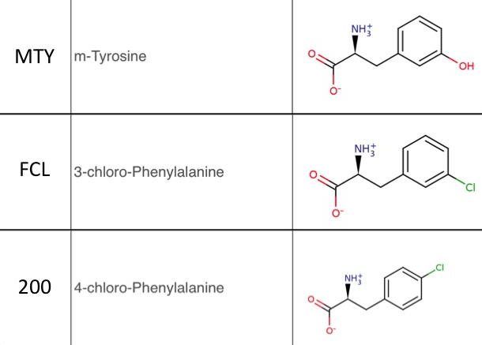
MTY
FCL
200

Slide 4
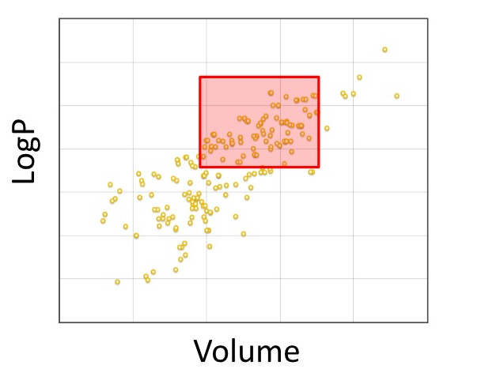

Slide 7
